Slide 1
AI CHATBOT FOR TRIP GUIDE
PIP2001 Capstone Project
Review-0
Batch Number: 22
Roll Number | Student Name
20211CSE0092 | ROHIT BHUNIA
20211CSE0331 | ISHA BHARDWAJ
20211CSE0324 | HEMA DEEPIKA M.
Under the Supervision of,
Dr./Mr./Ms./Prof : Dr. Pamela Vinitha Eric
Professor / Associate Professor / Assistant Professor
School of Computer Science and Engineering
Presidency University
Name of the Program: CSE
Name of the HoD: Dr. Blessed Prince P/Dr. Robin Rohit/Dr.Asif Mohammed H.B
Name of the Program Project Coordinator: Mr. Amarnath J.L & Dr. Jayanthi. K.
Name of the School Project Coordinators: Dr. Sampath A K / Dr. Abdul Khadar A / Mr. Md Ziaur Rahman

Slide 2
Content
Problem Statement
Github Link
Analysis of Problem Statement
Timeline of the Project
References

Slide 3
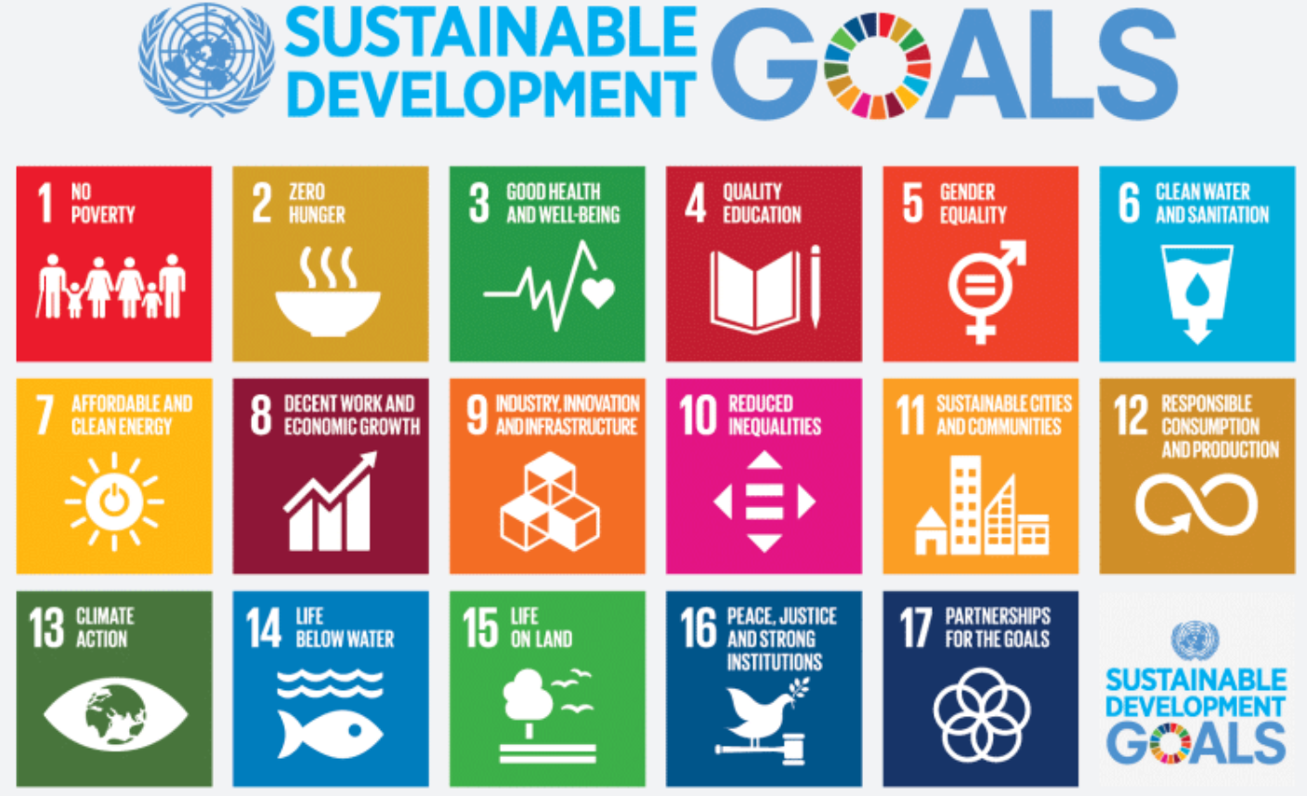
Github Link
The Github link provided should have public access permission.
Group 22 Github Link

Slide 4
Problem Statement Number:
Organization:
Category (Hardware / Software / Both) : Software
Problem Description: PSCS42
Difficulty Level: Moderate

Slide 5
Analysis of Problem Statement
Technology Stack Components:
1. Frontend:
Node.js: For building a responsive user interface.
HTML5/CSS3: To structure and style the frontend.
JavaScript: Core language for the frontend logic.
Bootstrap: For faster UI development with pre-built components.
2. Backend:
Node.js: For handling HTTP requests, APIs, and chatbot logic.
Python (Flask/FastAPI/Django): For AI/ML integration, especially if using Python-based ML models.
Golang: For efficient microservices, high-performance backend tasks, or handling high traffic.
REST API: To enable communication between the frontend and backend, serving responses and trip data dynamically.
3. AI and Natural Language Processing (NLP):
OpenAI API (ChatGPT, GPT-4): For pre-trained language models that understand and generate human-like text.
4. Database:
MongoDB: NoSQL database to store unstructured data like chat logs, user preferences, etc.
PostgreSQL/MySQL: Relational databases to store structured data, such as user accounts, booking info, and trip data.

Slide 6
Analysis of Problem Statement
Technology Stack Components:
5. APIs:
Google Maps API: To provide location-based services like finding points of interest, routes, etc.
6. Machine Learning/Deep Learning Frameworks:
TensorFlow: For building and deploying machine learning models.
PyTorch: For custom deep learning models, such as Chabot language understanding.
7. Cloud Infrastructure:
AWS (EC2, Lambda, S3): For scalable cloud computing, storage, and serverless deployment.
Google Cloud (Dialogflow): For hosting AI models and leveraging Dialogflow for Chabot conversations.
8. DevOps and CI/CD:
GitHub/GitLab: For version control and collaboration.
9. Security:
OAuth 2.0/OpenID Connect: For secure authentication and authorization.
10.Monitoring and Analytics:
Google Analytics: For tracking user interactions with the Chabot.

Slide 7
Analysis of Problem Statement (Software and Hardware requirement)
Software Requirements:
1. Programming Languages:
Python: Widely used for AI, ML, and NLP. Libraries like TensorFlow, PyTorch, and spaCy are crucial for AI tasks.
JavaScript/Node.js: For the backend and to handle APIs, particularly for real-time interactions.
Golang: For handling fast backend microservices if needed.
2. AI & Machine Learning Frameworks:
TensorFlow or PyTorch: For building and training machine learning models.
OpenAI API / GPT Models: To use pre-trained models like GPT for natural language understanding.
3. Databases:
MySQL/PostgreSQL: To store user data, conversation history, and guide recommendations.
MongoDB: For handling large unstructured data (e.g., location-based data or reviews).
4. Cloud Platforms & Services:
Google Cloud (DialogFlow): Cloud-based NLP engine that simplifies Chabot development.
Amazon Web Services (AWS Lambda): For scalable cloud hosting and serverless computing.
Azure Cognitive Services: For AI services, especially speech-to-text and text-to-speech.
5. APIs and SDKs:
Google Maps API, Foursquare API, Ticketmaster API, OpenWeather API, Wikipedia API: For better guidance.
Hardware Requirements: Development Machine: CPU: At least Intel i5 or equivalent AMD Ryzen 5. RAM: 16 GB minimum (32 GB recommended for model training).Storage: SSD with at least 500 GB (more if storing large datasets).
.

Slide 8
Analysis of Problem Statement (contd...)
Problem Statement: The primary problem that AI chatbots aim to solve in the travel sector is the need for efficient, scalable, and personalized customer service. As the travel industry faces a surge in customer inquiries and demands for real-time assistance, traditional customer service methods often fall short. This leads to long wait times, customer frustration, and ultimately, a negative impact on customer satisfaction and loyalty.
AI trip guides are increasingly recognized for their transformative role in the travel industry. They enhance the travel experience through various features and capabilities that cater to modern travelers' needs. Here are some key aspects highlighting their importance:
ØPersonalized Travel Planning
ØEnhanced Customer Experience
ØEfficient Booking Processes
ØMultilingual Support
ØReal-Time Updates
ØPredictive Analytics

Slide 9
Timeline of the Project (Gantt Chart)
Review Dates S. No. Review(Offline) Dates
Review-0 04-Sep-2024 To 06-Sep-2024
Review-1 24-Sep-2024 To 27-Sep-2024
Review-2 15-Oct-2024 To 21-Oct-2024
Review-3 19-Nov-2024 To 22-Nov-2024
5. Final Viva-Voce * 17-Dec-2024 To 20-Dec-2024
Review – 0 (10 Marks, 5%)
Title Finalization with Supervisor - Day 1-2: Initial meeting
Literature Survey (Week 2): Begin gathering research papers
Finalizing objectives (week 2): Draft a list of potential objectives
Deciding the methodology (week 3) : Explore different AI methodologies for chatbot development (e.g., NLP techniques, machine learning models, or rule-based systems).

Slide 10
References
Saluja, Gurucharan & Maheswari, N. & T S, Pradeep Kumar & M, sivagami. (2021). AI based intelligent travel chatbot for content oriented user queries. International Journal of Applied Science and Engineering. 1. 1-8. 10.6703/IJASE.202106_18(2).007.
Ukpabi, Dandison & Aslam, Bilal & Karjaluoto, Heikki. (2019). Chatbot Adoption in Tourism Services: A Conceptual Exploration. 10.1108/978-1-78756-687-320191006
R, Mr & M, Ambika & N, Geethanjali. (2022). Implementation of Travel Chatbot using NLP and Python. International Journal of Advanced Research in Science, Communication and Technology. 351-354. 10.48175/IJARSCT-5035.
V., Vijayaraghavan & Cooper, Jack & J., Rian. (2020). Algorithm Inspection for Chatbot Performance Evaluation. Procedia Computer Science. 171. 2267-2274. 10.1016/j.procs.2020.04.245.
Benaddi, Lamya & Ouaddi, Charaf & Jakimi, Abdeslam & Ouchao, Brahim. (2024). A Systematic Review of Chatbots: Classification, Development, and Their Impact on Tourism. IEEE Access. PP. 1-1. 10.1109/ACCESS.2024.3408108.
https://www.researchgate.net/publication/371491011_CHATBOT_ADOPTION_IN_TRAVEL_AND_TOURISM_SERVICES

Slide 11


